Slide 1

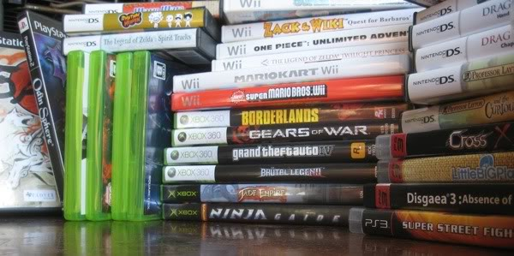
12. More Games
Let’s Learn
Aj. Andrew Davison, CoE, PSU Hat Yai Campus
E-mail: ad@fivedots.coe.psu.ac.th

Slide 2
Outline
I don't have time to teach these in class, but they contain interesting features.
Look at the code, and if you don't understand it, please contact me.
Whack-a-Mole
Snake
Fred's Bad Day
Breakout
Breakout with High Scores
Bomber Pilot
Tetrominoes
Tic-Tac-Toe
Menu Test
Card Game Basics
Tank
Platformer
15-Puzzle
15-Puzzle with Tweening
Cannon
Cannon with Physics

Slide 3
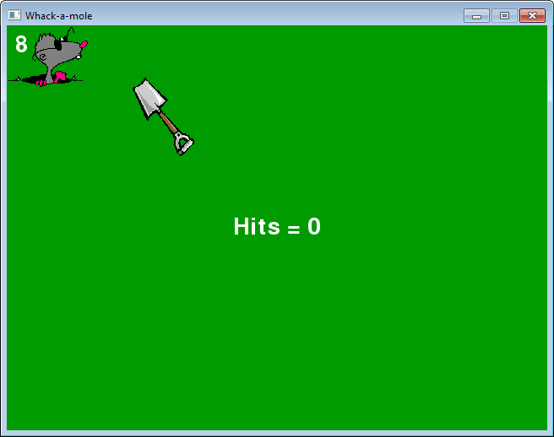
1. Whack-a-Mole

Slide 4
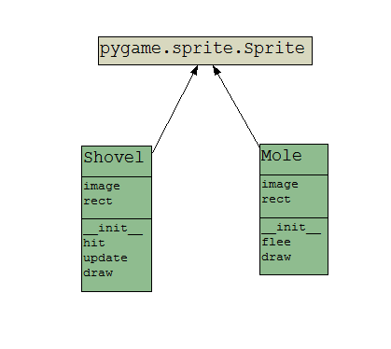
Classes Used

Slide 5
Interesting Features
The shovel follows the mouse
uses MOUSEMOTION and MOUSEBUTTONDOWN events in the game loop
Displays the passing time in seconds
uses pygame.time.get_ticks(), which returns milliseconds, ms

Slide 6
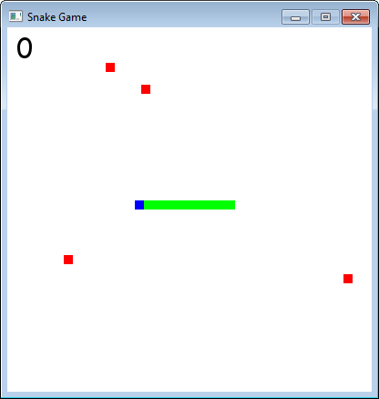
2. Snake

Slide 7
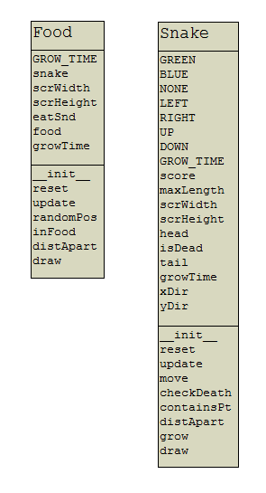
Classes Used

Slide 8
Interesting Features
Separate files for the Food and Snake classes
they are imported into SnakeGame.py
I use a Snake.isDead attribute instead of the usual gameOver variable
Time-constraints used to create new food and make the snake longer.
"Distance apart" calculations work out if the snake is 'near' enough to food to eat it

Slide 9
The Food and Snake classes do not inherit Sprite since they do not use images.

Slide 10
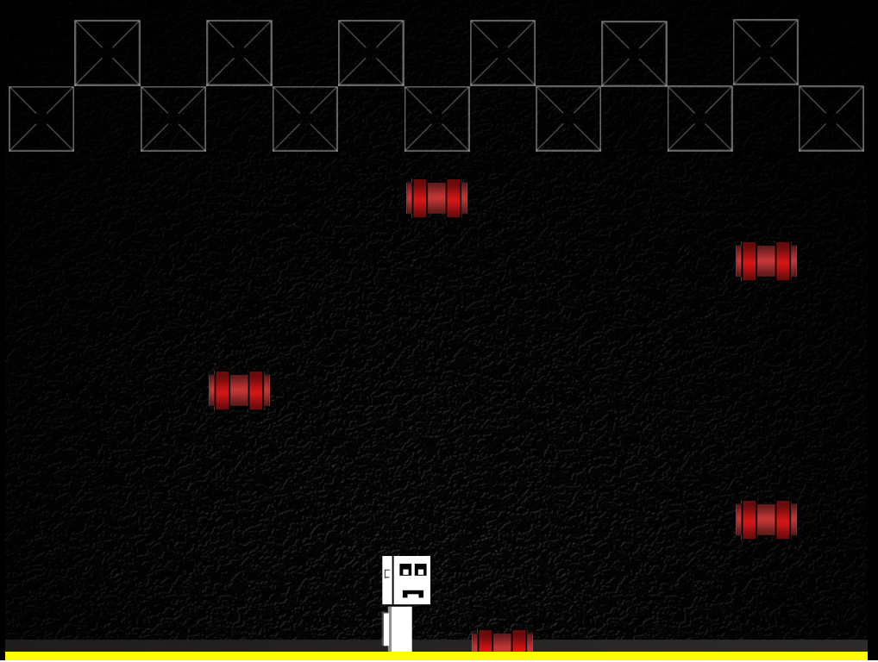
3. Fred's Bad Day
A full-screen game

Slide 11
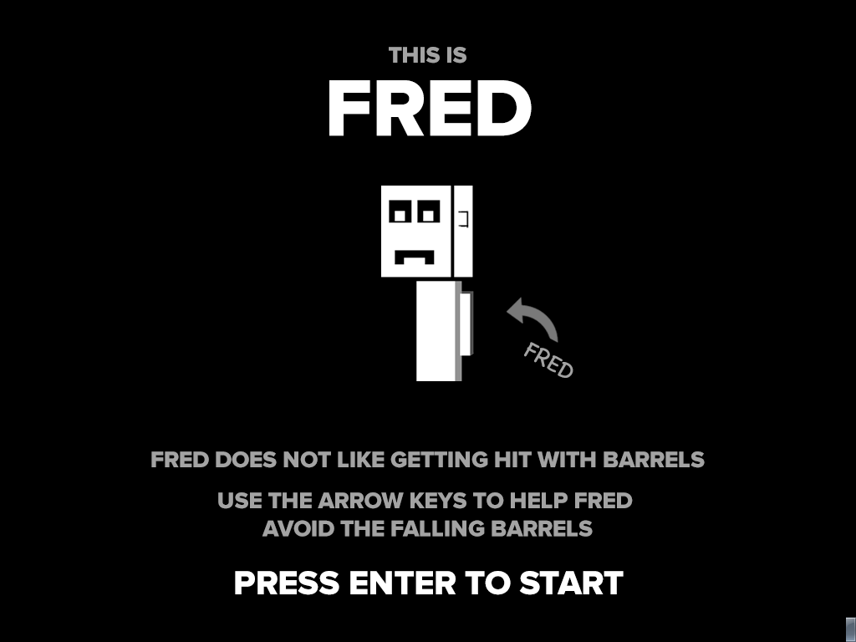
Start Screen

Slide 12
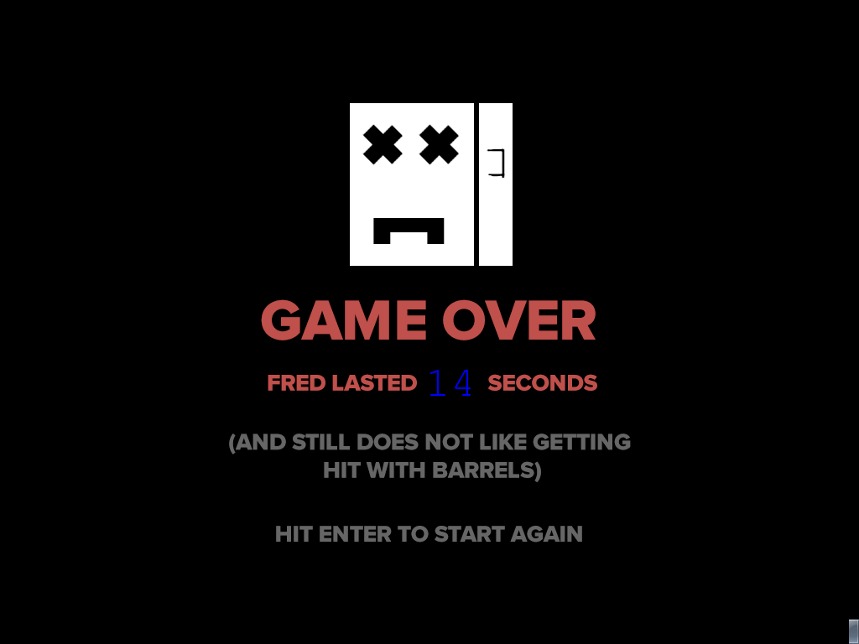
Restart Screen

Slide 13
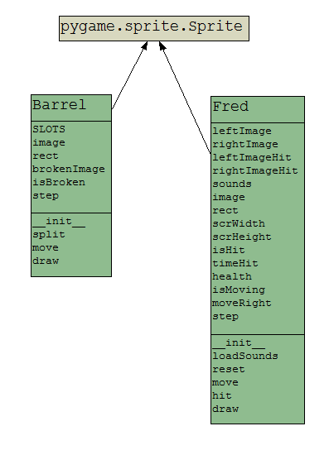
Classes Used

Slide 14
Interesting Features
Separate files for the Barrel and Fred classes
they are imported into BadDay.py
A time-constraint decides when to create a new barrel
see updateBarrels() in BadDay.py
The end of a game includes a restart screen
lets gameOver be reset to False

Slide 15
The game uses FULLSCREEN mode
screen = pygame.display.set_mode([1000,768], pygame.FULLSCREEN)
KEYDOWN and KEYUP events allow repeated movement left and right.
Fred's life points are represented by a yellow rectangle drawn at the bottom of the window

Slide 16
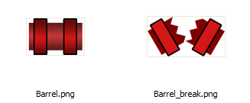
The game's images, music and sound effects are stored in an assets/ sub-directory.
Barrel start positions are stored in a class variable called SLOTS in the Barrel class
A barrel 'splits' into two, by changing its display image
from Barrel.png to Barrel_break.png

Slide 17
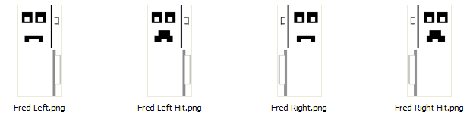
Fred can change between 4 different images
There is a time-constraint on Fred for how long he is "hit" by a barrel, which affects which image is shown
see start of Fred.move() and Fred.draw()

Slide 18
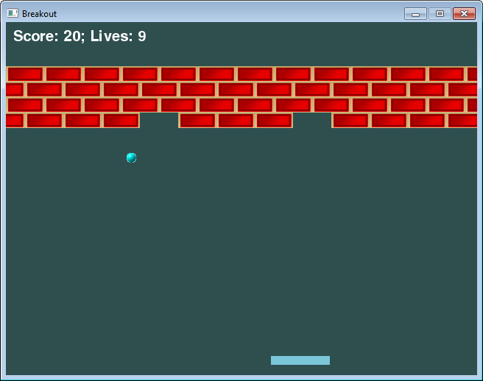
4. Breakout

Slide 19
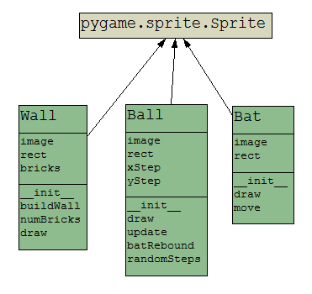
Classes Used

Slide 20
Interesting Features
A more complex version of pong.py
The wall is a single sprite that stores a list of (x,y,w,h) rectangles in self.bricks
see build() in the Wall class
Wall.draw() draws a single brick image multiple times at each of the (x,y) rectangle coordinates

Slide 21
The ball rebounds from the bat in a complex way along the x-axis
it depends on the position of the ball's center relative to the bat's center
see Ball.batRebound() and Ball.update()
The ball rebounds off a brick differently depending on if it hits the sides or top/bottom of the brick's rectangle.
see Ball.update()

Slide 22
Unlike pong.py, there is no Block class since the collisions on the walls are implemented using scrWidth and scrHeight calculations
see Ball.update()
If the player removes all the bricks, the wall is recreated; the game continues until the no. of lives == 0
see call to wall.build() at the end of Ball.update()

Slide 23
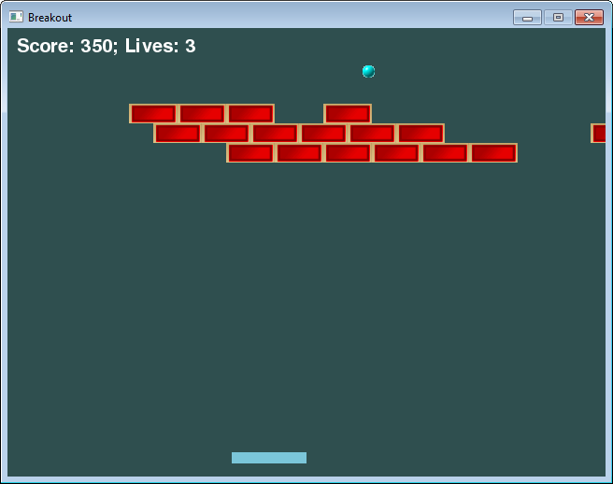
5. Breakout with High Scores

Slide 24
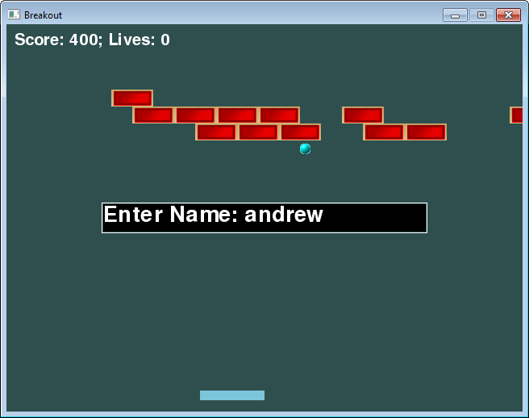
Name Entry at Game End
you
type the
name and
then enter

Slide 25
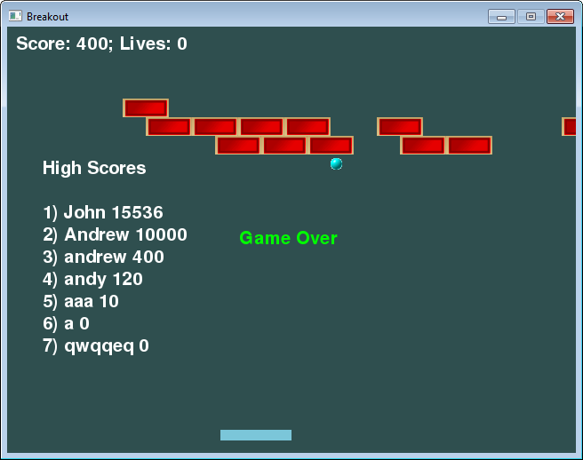
High Scores List
these
scores
are
remembered
across
games

Slide 26
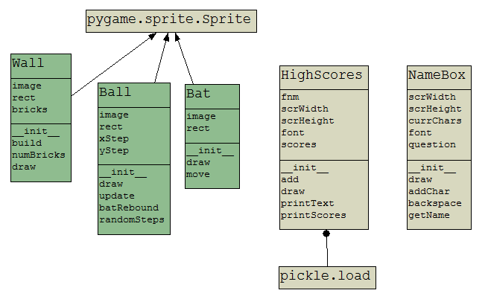
Classes Used
new classes

Slide 27
Interesting Features
The NameBox and HighScores classes are imported into main:
from NameBox import NameBox
from HighScores import HighScores
Two extra game state booleans: enteringName and showingScores
gameOver → enteringName → showingScores
represents 3 stages of finishing
gameOver is implemented using a lives counter

Slide 28
Redirection of text input to NameBox object inside event handling
The NameBox object deals with text entry, and handles backspaces
The HighScores class stores a Python list of (name,score) pairs in a binary file using the Pickle module
The list is sorted, and only the top-10 highest scores are stored in the file.

Slide 29
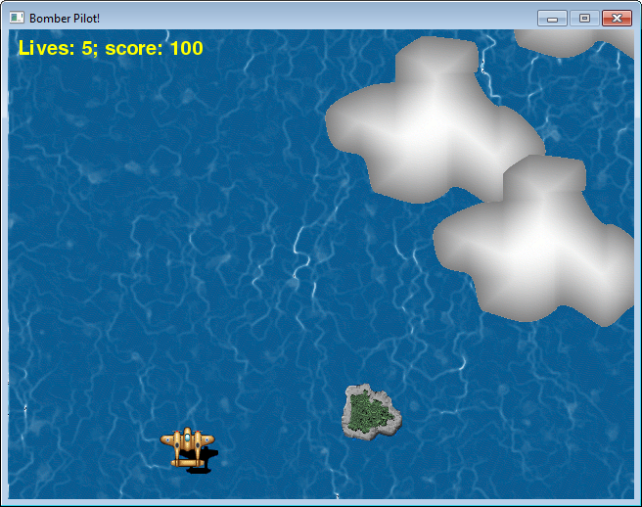
6. Bomber Pilot

Slide 30
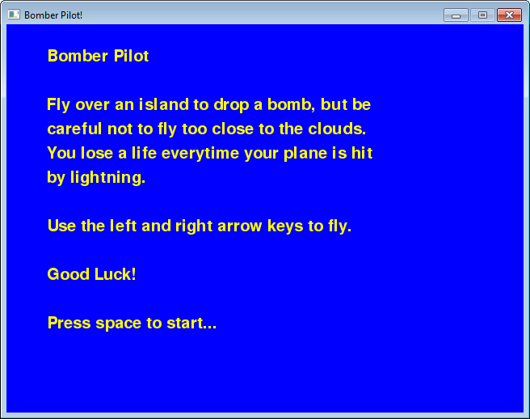
Start Screen

Slide 31
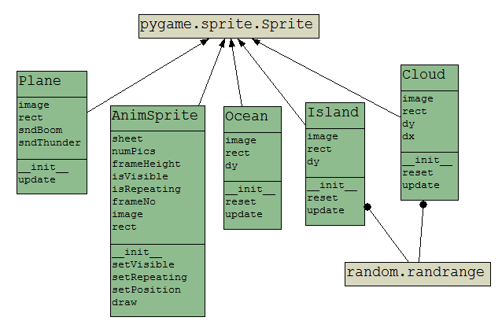
Classes Used

Slide 32
Interesting Features
This is a top-down scroller, similar to the "Skier" example, except the plane appears to be moving up the screen.
In fact, the plane does not move vertically, instead the clouds, islands, and the ocean background move down.
The ocean background resets when the top of its image reaches the top of the window
the reset causes the bottom of the image to be aligned with the bottom of the window

Slide 33
The start screen is generated by calling renderInstructions() with a list of text lines.
There are two animated sprites: one for explosions, and another for lightning.

Slide 34
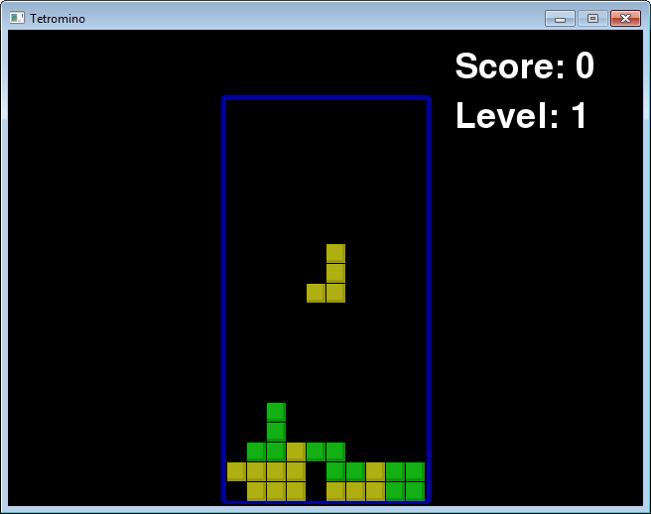
7. Tetrominoes

Slide 35
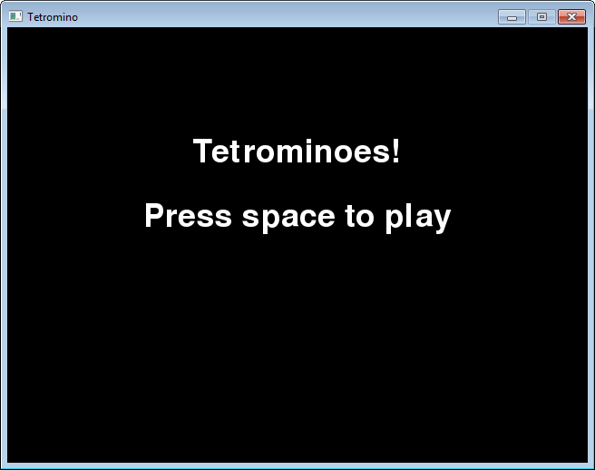
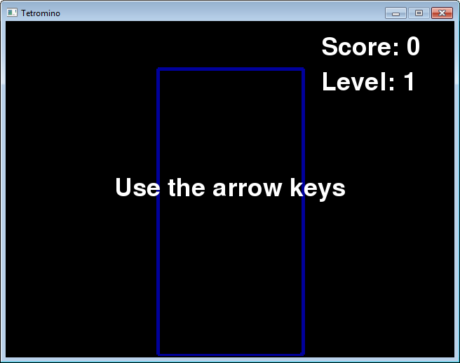
Start Screen and Instructions
Help instructions

Slide 36
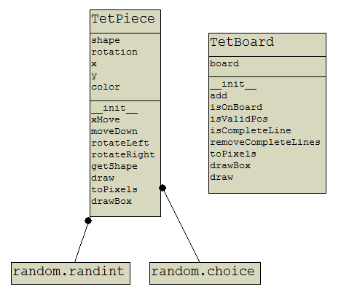
Classes Used

Slide 37
Interesting Features
A clone of the famous "Tetris" game
https://en.wikipedia.org/wiki/Tetris
This code is based on the game in Chapter 7 of "Making Games with Python and Pygame" by Al. Sweigart, but changed to use classes, sprites, and a simpler game loop
a copy of the chapter is included in "tets.pdf"

Slide 38
The game can be paused, and help shown
requires game state variables isPaused and showHelp
Two classes:
TetPiece: represents the current falling piece
TetBoard: represents the board, including all the squares at the bottom of the board
Two time-constraints:
a piece is moved down after a fixed amount of time, which gets less as the game progresses
a user can only press a key every 0.1 sec

Slide 39
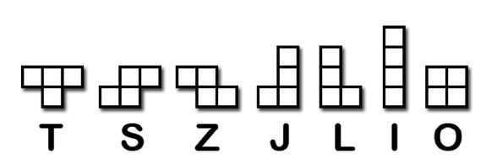
TetPiece stores the definition of the 7 shapes for the pieces, which are made up of 4 squares each.
Each shape template defines the look of the piece when it is rotated 90°, so a template may consist of at most 4 different 'shapes'
this large amount of data makes the coding of shape rotation much smaller

Slide 40
The TetBoard class stores the squares on the board in a self.board 2D list.
board[x][y], where y is the row
y == 0 is the top row of squares in the board
When a piece lands on the board, the squares in the piece are added to the squares already in self.board, and any complete rows (lines) are deleted.
When a line is deleted, the rows (lines) above it must be moved down
this means moving row y to row y+1

Slide 41
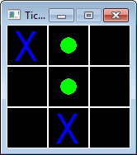
8. Tic-Tac-Toe
You (o) versus the computer (x)

Slide 42
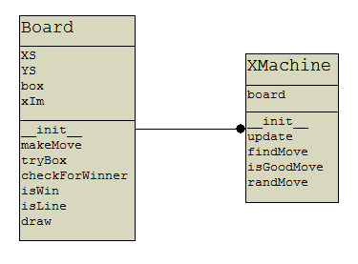
Classes Used

Slide 43
Interesting Features
A turn-based game, where the other player is the computer.
The turn state is implemented using a isPlayerTurn boolean.
The computer player is implemented by the XMachine class
so named since it is the "X" player in the game

Slide 44
Both XMachine and the human player use the Board class, which is the Tic-Tac-Toe board
the board is a 9 element list using the format:
0 1 2
3 4 5
6 7 8
XMachine is not a clever Artificial Intelligence (AI) program since Tic-Tac-Toe is so simple
XMachine checks all the 8 ways of winning in TicTacToe – 3 across, 3 down, and 2 diagonals

Slide 45
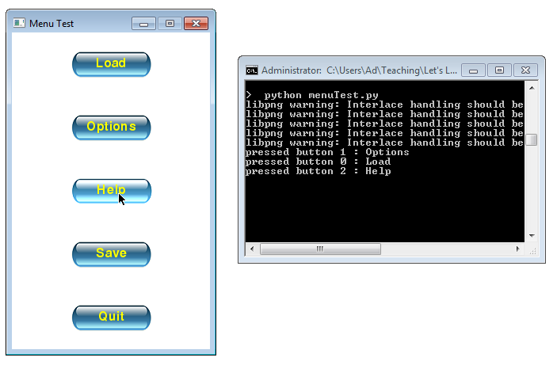
9. Menu Test

Slide 46
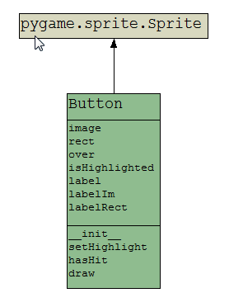
Classes Used

Slide 47
Interesting Features
menuTest.py is not a game, but an example of how to use Button objects to build a menu.
This Button class is a slightly extended version of the Button class in the Skier game
this class changes the color of the button when the mouse moves over it
The menu items can be selected by mouse clicking or by using the up, down and enter keys

Slide 48
The button objects are stored in a list called buttons in main
The buttons do not do anything themselves.
Instead when a button is selected, the game loop sets a pressedIdx variable to the index number of the button in the list
The selection of a button plays a 'click' sound.

Slide 49
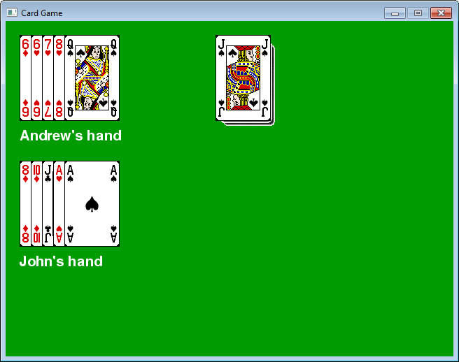
10. Card Game Basics
the Deck object
showing the
current top card
two Hand objects
each with 5 cards
the cards are
manipulated
using the three
mouse buttons
and mouse
dragging

Slide 50
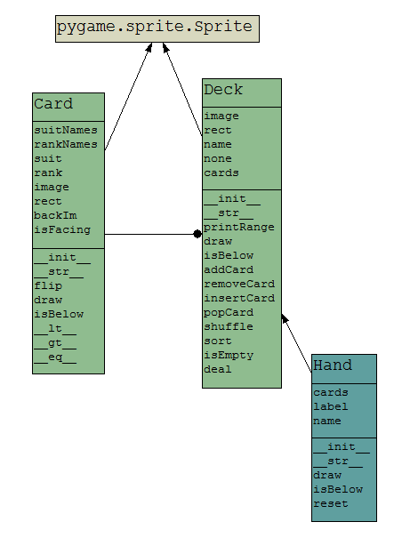
Classes Used

Slide 51
Interesting Features
Basic classes for Card, Deck and Hand along with a game loop that allows card movement, card flipping, card position resetting, and deck rotation
The cards in a hand can be moved by selecting and dragging with the left mouse button.
The position of the cards in the hands can be reset to their starting position by clicking on any card using the middle mouse button.

Slide 52
A card can be turned over by clicking on it using the right mouse button.
The top card of the deck can be moved to the bottom by clicking on it with the left mouse button.

Slide 53
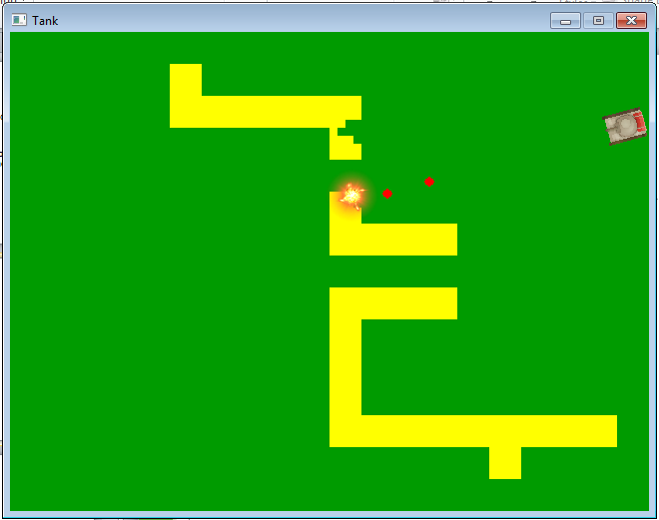
11. Tank
Shell sprites
Made from
Brick sprites

Slide 54
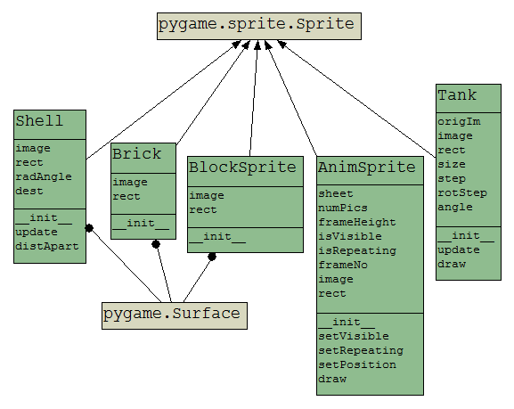
Classes Used

Slide 55
Interesting Features
The tank sprite is rotatable, and can move forwards and backwards.
The tank can shoot Shell sprites forwards from its gun.
The walls are generated using 8x8 Brick sprites, which are destroyed when a Shell sprite hits them.
The walls are specified using a text-based 'map' which is converted into sprites at run-time.

Slide 56
The tank cannot drive off the window (because of BlockSprites) or through walls.
When a big-enougth hole has been made in a wall, the tank can drive through it.
The shell explosions are AnimSprite objects

Slide 57
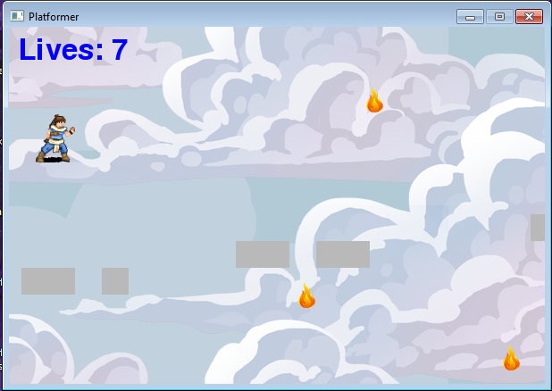
12. Platformer
fireballs
player
jump
platforms

Slide 58
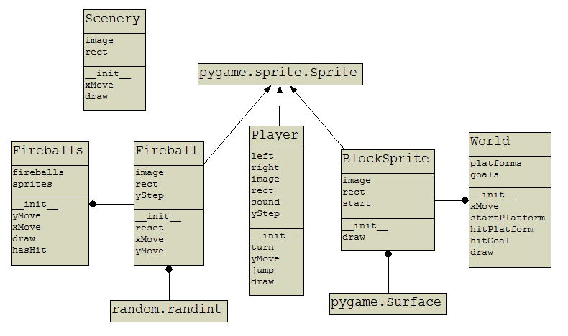
Classes Used

Slide 59
Interesting Features
This is a simple side-scroller platform game
the player appears to move left and right, but doesn't actually move horizontally
instead the background, platforms, and fireballs move horizontally in the opposite direction
The player can jump up, and is affected by gravity which makes it come back down
it can land on a platform or on the floor (the base of the window)

Slide 60
The platforms and goal are defined in a text-based map, which are converted into BlockSprite objects at run-time
a similar technique is used in the tank game for creating the walls as Bricks
The platforms and goal are created and managed by the World class
The platforms extend beyond the right-hand side of the window, but become visible as the player moves right.

Slide 61

The background image was chosen such that it's left side matches its right side
the background moves left and right, but slower than the foreground platforms to mimic the idea that it is further away
it is sometimes necessary to draw two copies of the background so that it seemlessly covers the entire window
this is handled by the Scenery class

Slide 62
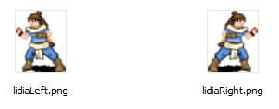
The player consists of a left-facing and right-facing version which changes depending on which way the player is moving.
A fireball is represented by a Fireball sprite, but all the fireballs are managed by the Fireballs class

Slide 63
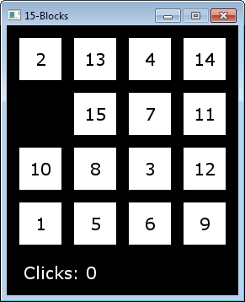
13. 15-Puzzle

Slide 64
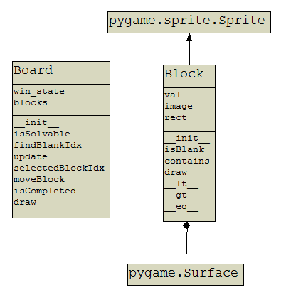
Classes Used

Slide 65
Interesting Features
This is another famous puzzle game, usually called the 15-puzzle
see https://en.wikipedia.org/wiki/15_puzzle
The 15 squares (and an invisible square for the space) are implemented as 16 Block sprites
When the user clicks on a block adjacent to the space, it instantly moves into that space
this is implemented by swapping the invisible block and the number block

Slide 66
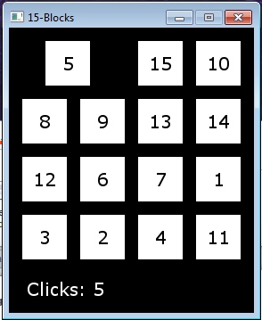
14. 15-Puzzle with Tweening
the move
takes some
time
Tweening means the creation of animation steps between the start and end position of a game movement.
Tweening is used here to make a number square move into the space over the course of a few animation frames, instead of instantly.

Slide 67
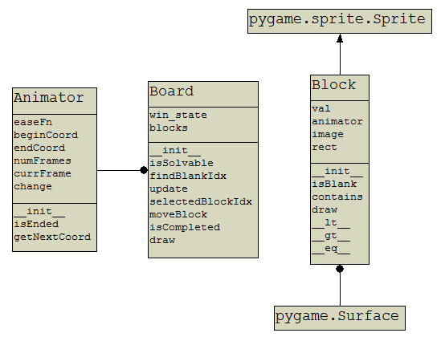
Classes Used
new class

Slide 68
Interesting Features
A related idea to tweening is easing which is a position equation (or function) to move beween a start and end position
the most common easing function is "linear" which means that the game object moves with a fixed velocity between the start and end position
this can be drawn as a graph showing position vs time:
position
position equation
time

Slide 69
The idea of tweening with easing was first developed by Robert Penner
see http://robertpenner.com/easing/
includes slides, a book chapter, code
Many easing equations have been defined which tween an object in interesting ways
see graphs on the next slide

Slide 70
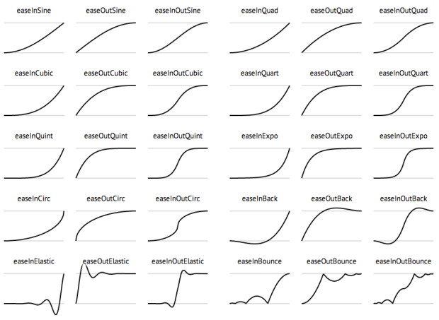
Some Easing Equations
used in my
program

Slide 71
Animating with Easing Functions
Penner's easing equations have been implemented as functions in many languages
e.g. Python code at https://gist.github.com/ cleure/e5ba94f94e828a3f5466
stored as easing.py in the code directory
My Animator class can use any of these easing functions to tween a block into the empty space.

Slide 72
Tweening as a Game State
The tweening of a block uses a new game state in the game loop: the isTweening boolean
When isTweening is true, updates to the game by the user are ignored until the tweening is finished; then isTweening is set to false

Slide 73
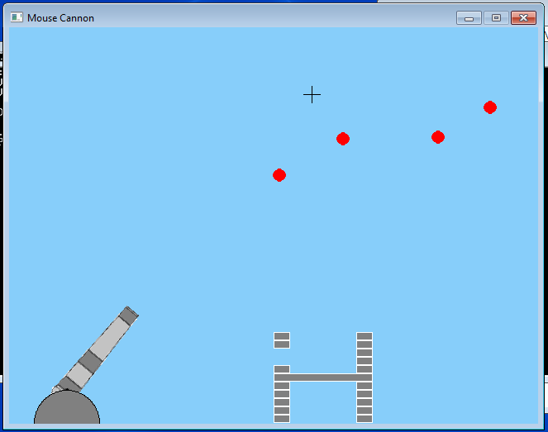
15. Cannon
the current mouse
position is drawn
in the game as
'crosshairs'
Only 5 shells can
be on-screen at
any time.
shells shoot out
from the current
position of the
end of the gun
and travel in a
straight line
shells: when
a shell hits a wall
it disappears
bricks: when
a shell hits a
brick, both of
them
disappear
cannon:
the gun rotates
to follow the
mouse position
bricks can be different sizes

Slide 74
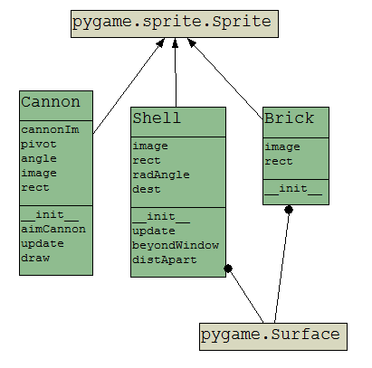
Classes Used

Slide 75
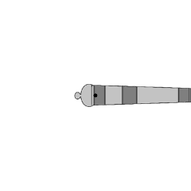
Rotating the Cannon
The cannon gun was drawn so that it's rotation point (a black dot) is at the center of the image:
gun.png

Slide 76
This means that rotating the gun image will always leave the rotation point unchanged at the center:

Slide 77
The gun image is drawn by Pygame using rect.center, which means that its rotation point (the center) will never move.
The base of the cannon is a gray circle drawn at the bottom of the window, so half of the circle cannot be seen.
not visible

Slide 78
Firing a Shell
The shells starting position (x, y) and its x- and y- steps are based on calculating the gun's angle to the x-axis, and on its barrel's length.
yStep
(x,y)
barrel
length
xStep
angle
(xRot,yRot)

Slide 79
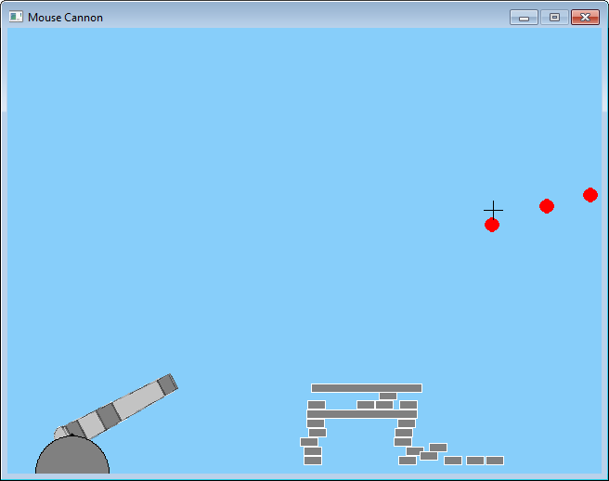
16. Cannon with Physics
Shells disappear when their
velocity is close to 0
The Pymunk module is
used to calculate the
physics of the moving
objects (the shells and
the bricks)
The shells and the
bricks move and
collide in much more
interesting ways, and
with less coding by us.
The cannon class
is unchanged
Bricks no longer disappear

Slide 80
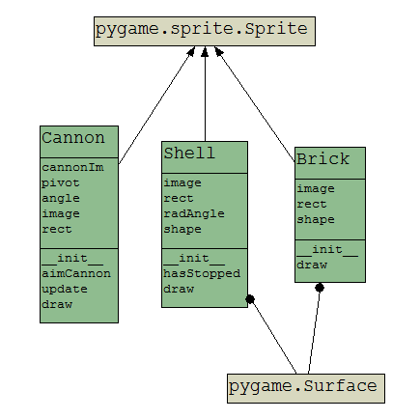
Classes Used
Shell and Brick
contain Pymunk
physics code in
the init functions
Cannon is
unchanged
No need for an
update() function;
Pymunk handles it

Slide 81
Pymunk
http://www.pymunk.org/en/latest/
A 2D physics library for implementing complicated (real-looking) movement and collisions between "rigid" (hard) shapes
uses mass, velocity, momentum, forces, gravity, etc.
Often used with pygame to add more real actions to a game.
How to install:
pip install pymunk
or https://pypi.python.org/pypi/pymunk/#downloads

Slide 82
Pymunk Info
A python interface to a C library called chipmunk
(http://chipmunk-physics.net/)
Downloaded pymunk-4.0.0.zip
source code, but also contains docs, examples
Online docs:
http://pymunk.readthedocs.io/en/latest/pymunk.html
Step-by=step programming example:
http://www.pymunk.org/en/latest/tutorials/SlideAndPinJoint.html
Example docs
http://www.pymunk.org/en/latest/examples.html
arrows.py (uses pygame)
breakout.py (uses pygame)

Slide 83
Chipmunk Tutorials
https://www.raywenderlich.com/3128/ chipmunk-tutorial-for-ios-how-to-create-a-simple-iphone-game
http://www.alexandre-gomes.com/ articles/chipmunk/
https://chipmunk-physics.net/tutorials/ SimpleObjectiveChipmunk/

Slide 84
Pymunk Ideas
Space: the world holding the objects
set gravity and other forces; it calculates velocities and positions for objects each time that step() is called
An object usually has two parts:
body: defines the mass, inertia, position
shape: Pymunk supports circle, poly, segment
necessary if you want shapes to collide
Pymunk cannot draw shapes
Joints: limits how objects can move
types: pins, pivots, sliders, grooves

Slide 85
Pymunk and Pygame
Use pymunk to update an object's position, velocity and collisions inside the game loop
No need for (much) code for updating game objects since pygame does most of it each time that space.step() is called
Pygame is used for drawing shapes
no need for collision detection or groups

